Slide 1
CLUSTERING ASSIGNMENT (HELP_NGO_COUNTRIES DATASET)
BY- SUBRAMANYA NAYAK

Slide 2
PROBLEM STATEMENT
HELP International is an international humanitarian NGO that is committed to fighting poverty and providing the people of backward countries with basic amenities and relief during the time of disasters and natural calamities. It runs a lot of operational projects from time to time along with advocacy drives to raise awareness as well as for funding purposes.
During the recent funding programs ,NGO have been able to raise around $10 million. As an analyst, we have to come up with the countries list that are in the direst need of aid.
OBJECTIVE
Our role is to analyse the given data among 167 countries and we need to categorise the countries using some socio-economic and health factors that determine the overall development of the country. Then you need to suggest the countries which the CEO needs to focus on the most. The datasets containing those socio-economic factors and the corresponding data dictionary are provided below.

Slide 3
DATA DICTIONARY
country: Name of the country
child_mort: Death of children under 5 years of age per 1000 live births
exports: Exports of goods and services per capita. Given as %age of the GDP per capita
health: Total health spending per capita. Given as %age of GDP per capita
imports: Imports of goods and services per capita. Given as %age of the GDP per capita
Income: Net income per person
Inflation: The measurement of the annual growth rate of the Total GDP
life_expec: The average number of years a new born child would live if the current mortality patterns are to remain the same
total_fer: The number of children that would be born to each woman if the current age-fertility rates remain the same.
gdpp: The GDP per capita. Calculated as the Total GDP divided by the total population.

Slide 4
ANALYSIS APPROACH
Reading and Data Understanding :
Data Cleansing:
Checking Null Values/ Treatment
Data Visualization:
Univariat Analysis
Multivariat Analysis
Data Preparation For Modelling:
Outlier Detection And Treatment
Scaling Data (Standardization)
Model Building:
Kmeans Clustering
Hierarchical Clustering
Final Analysis And Business recommendations:

Slide 5
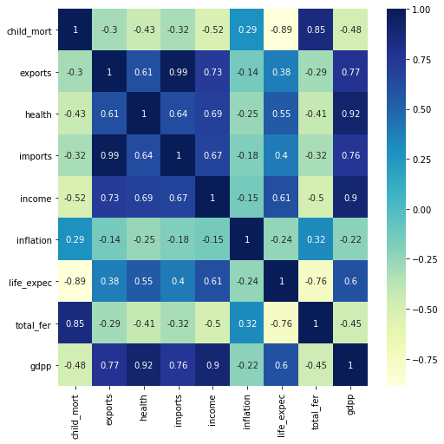
DATA VISUALISATION CORRELATION OF THE VARIABLES
From the heat map on the right side we can conclude below points:
Child_mortality And Life_expentency Are Highly Correlated With Correlation Of -0.89
Child_mortality And Total_fertility Are Highly Correlated With Correlation Of 0.85
Imports And Exports Are Highly Correlated With Correlation Of 0.74
Life_expentency And Total_fertility Are Highly Correlated With Correlation Of -0.76

Slide 6
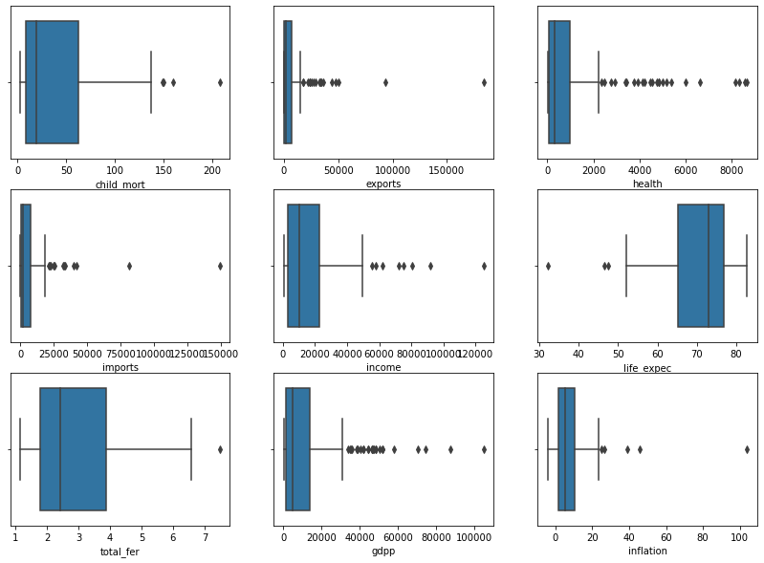
VISUALIZATION OF OUTLIERS
From the boxplots attached below, below points can concluded:
As we can see that all boxplots created for numeric variables are having outliers.
All boxplots expect “life_expec” is having outliers on bottom of the boxplot which means there are some countries where avg number of years a new born child whould live is very less compared to the other countries.
The imports and exports boxplot is having very thin size of IQR compared to others.

Slide 7
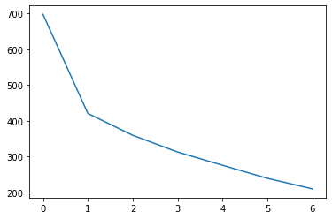
K-MEANS CLUSTERING
We are trying find optimal number of k-value based on business requirements.
So, to achieve this we used elbow-curve and silhoutte analysis to finfd the score range of cluster values.
ELBOW – CURVE
We can see in elbow curve that highest peak is at “2” but “2” is never a good number for clustering , so we will go with k=3.

Slide 8
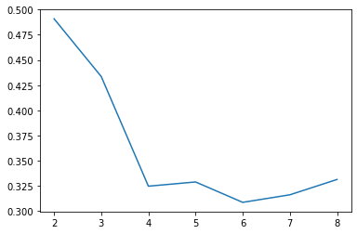
SILHOUTTE ANALYSIS
For n_clusters=2, the silhouette score is 0.4980
For n_clusters=3, the silhouette score is 0.4336
For n_clusters=4, the silhouette score is 0.3235
For n_clusters=5, the silhouette score is 0.3245
For n_clusters=6, the silhouette score is 0.3371
For n_clusters=7, the silhouette score is 0.3178
For n_clusters=8, the silhouette score is 0.3259
We found that cluster “2” is having highest score hence k value should be “2”, but if we choose k value as “2” it will suit business needs.
Hence, use k value as “3”, since it will give precise and meaningfull clusters and also fullfills business requirements.

Slide 9
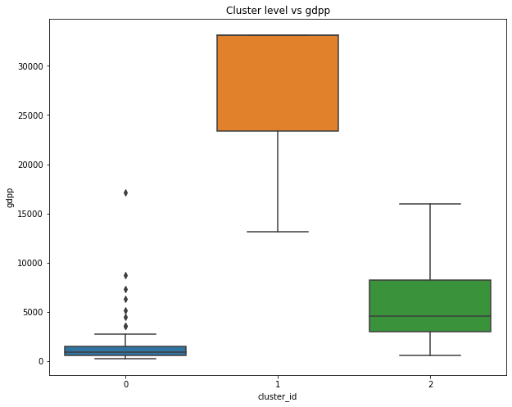
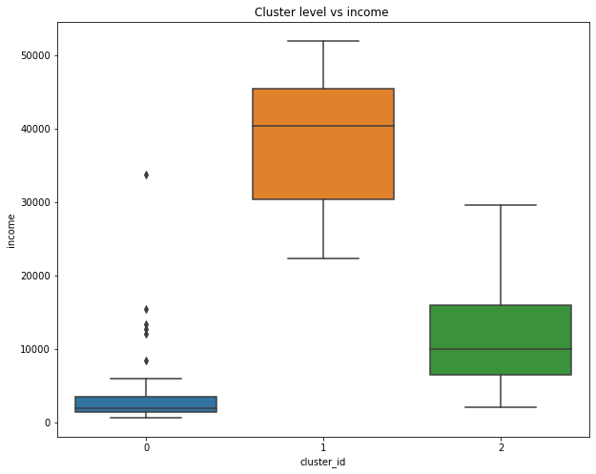
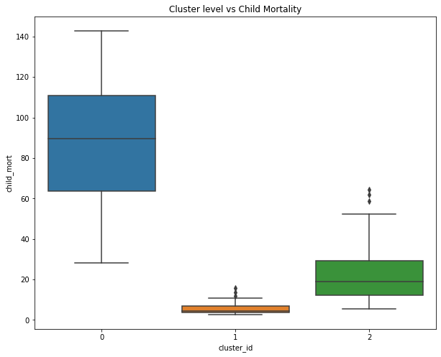
VISUALIZATION OF CLUSTERS

Slide 10
From the above cluster groups we can easily group them as Developed countries, Developing countries and under –developed countries.
Cluster “0” being under-developed coubtries list because their GDP and INCOME is low and “Child Mortality” is high so cluster “0” is our main focus for providing aid to countries.
Cluster “1” being Developed countries list because their GDP and INCOME is high and “Child Mortality” is low .
cluster “2” being developing countries list because their GDP , INCOME and “Child Mortality” is average .

Slide 11
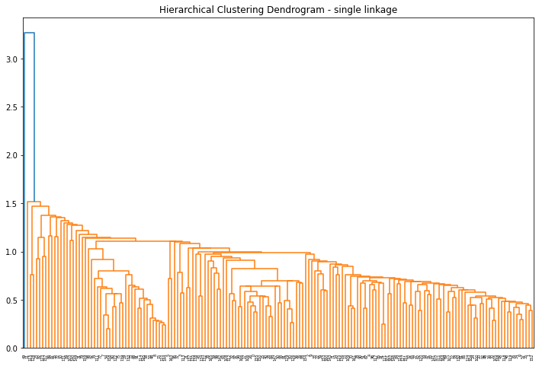
HIERACHICAL CLUSTERING
Single linkage:
This is another method clustering
As we can see from dendrogram of single linkage, it is not quite visible and doesn’t suits properly with the dataset because we can conclude the threshold value to cut dendrogram.

Slide 12
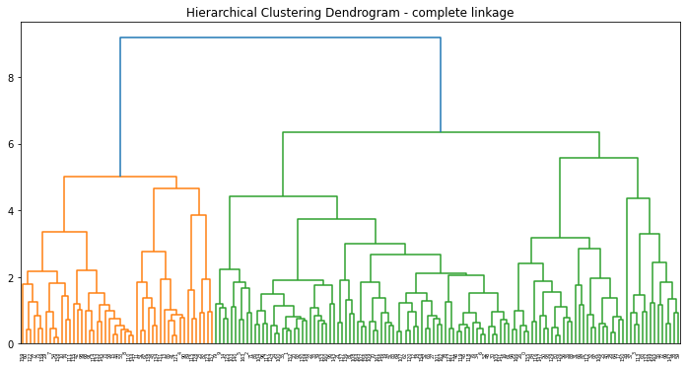
Complete linkage:
From single we cann’t conclude threshold so we will use complete linkage.
Points noted from the dendrogram .
This shows proper way to decide the threshold for decide the number of
clusters. We will cut at “3”branches which will give us 3 clusters.

Slide 13
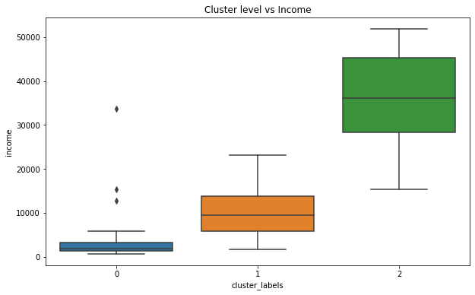
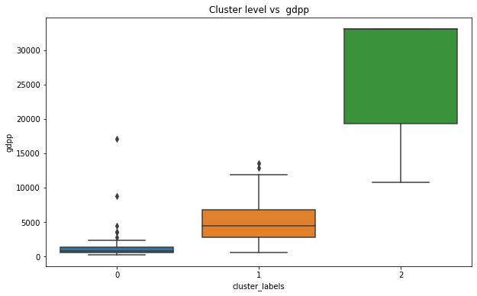
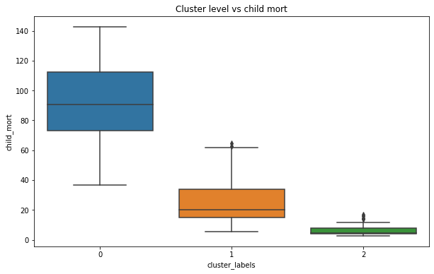
VISUALIZATION OF CLUSTERS

Slide 14
From the above cluster groups we can easily group them as Developed countries, Developing countries and under –developed countries.
Cluster “0” being under-developed coubtries list because their GDP and INCOME is low and “Child Mortality” is high so cluster “0” is our main focus for providing aid to countries.
Cluster “1” being developing countries list because their GDP , INCOME and “Child Mortality” is average .
Cluster “2” being Developed countries list because their GDP and INCOME is high and “Child Mortality” is low .

Slide 15
Top 10 Countries obtained from both Models are:
Sierra Leone
Central African Republic
Haiti
Chad
Mali
Nigeria
Niger
Angola
Congo, Dem. Rep.
Burkina Faso
Sierra Leone
Central African Republic
Haiti
Chad
Mali
Nigeria
Niger
Angola
Congo, Dem. Rep.
Burkina Faso
K-means clustering
Hierachical clustering

Slide 16
RESULTS:
My result is same in both methods which is same top 10 countries and i sorted countries by considering the lowest gdpp.
We have seen from both methods - (K-Means and Hierarchical clustering) that top 10 countries are are similar. I would choose the final countries from hierarchical clustering because the comlete linkage give us accurate output than k-means clustering. I have compared the clusters and visualized from both methods and hierarchical clustering gave precise information than K-Means clustering.

Slide 17
CONCLUSION
After grouping all the countries into 3 groups by using some socio-economic and health factors, we can determine the overall development of the country.
Here, the countries are categorised into list of developed countries, developeing countries and under-developed countries.
In Developed countries, we can see the GDP per capita and income is high where as Death of children under 5 years of age per 1000 live births i.e. child-mort is very low, which is expected.
In Developing countries and Under-developed countries, the GDP per capita and income are low and child-mort is high. Specifically, for under-developed countries, the death rate of children is very high.

Slide 18
Final list of countries
We got same top 10 countries from both hierachical and k-means clustering model that are in dire need of aid:
Sierra Leone
Central African Republic
Haiti
Chad
Mali
Nigeria
Niger
Angola
Congo, Dem. Rep.
Burkina Faso
These are the countries, categorized using socio-economic and health factors (i.e gdpp, income and Child Mortality) that determine the overall development of the country.

